Slide 1
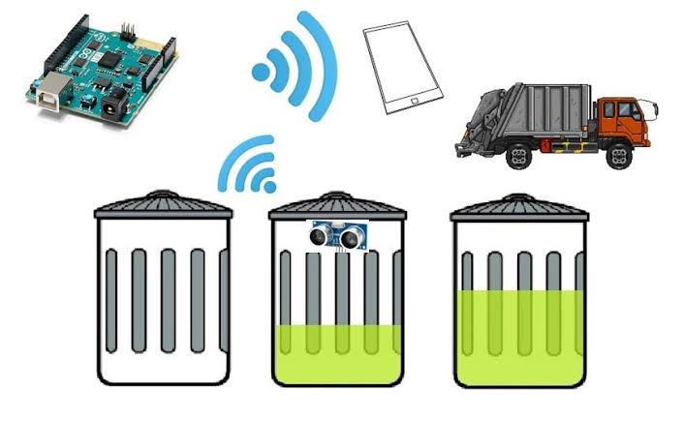
SMART GARBAGE MONITORING SYSTEM

Slide 2
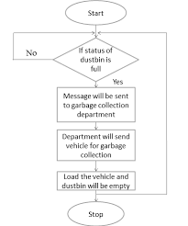
INTRODUCTION:
The IOT Garbage Monitoring System is a very innovative system which will help to keep the cities clean.This arrangement monitors the garbage bins and notifies about the level of garbage collected in the garbage bins via a web page.

Slide 3

PROBLEM STATEMENT:
ONE OF THE MAIN CONCERNS WITH OUR ENVIRONMENT HAS BEEN SOLID WASTE WHICH IMPACTS THE HEALTH AND ENVIRONMENT OF OUR SOCIETY.
THE DETECTION,MONITORING AND MANAGEMENT OF WASTES IS ONE OF THE PRIMARY PROBLEMS OF PRESENT ERA.
THIS PROBLEM CAN BE AVOIDED WITH LESS HUMAN EFFORT AND COST USING OUR PRESENT TECHNOLOGIES

Slide 4
SOLUTION:
The proposed system helps to avoid the dustbin from overflowing. It will provide the actual information about the dustbin level. This projected structure of waste management can save the time, also reduces the human effort . The utilization of Internet in this process makes this system capable and consistent.
The Ultrasonic sensors and buzzers are connected to the microcontroller whereas the Wi-Fi connector is attached with the microcontroller. The Wi-Fi with the microcontroller is connected with the major support of power supply. The quantity of trash is measured by sensing using ultrasonic sensors connected with microcontroller and allowed to pass the data to the website through the help of WiFi.

Slide 5
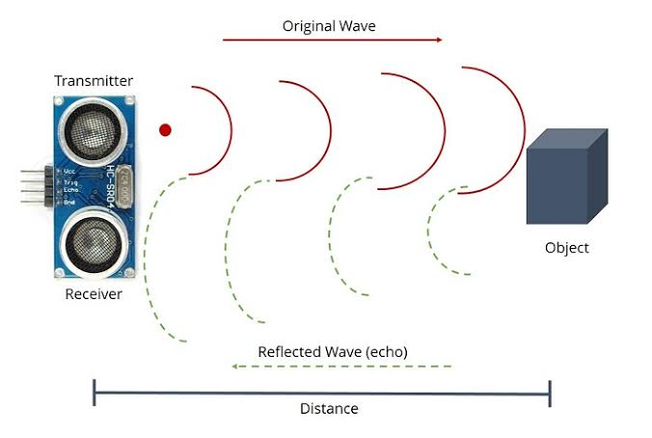
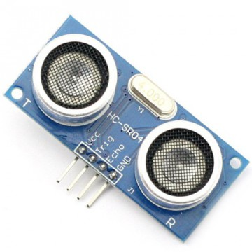
COMPONENTS:
ULTRASONIC SENSOR:
THE SENSOR MEASURES DISTANCE TO THE TARGET BY MEASURING TIME BETWEEN EMISSION AND RECEPTION USING ULTRASONIC WAVES

Slide 6
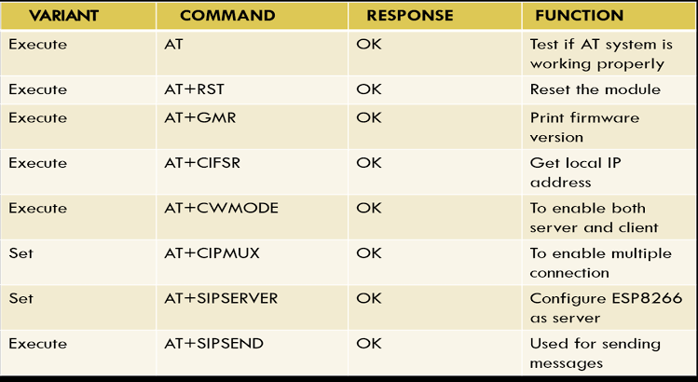
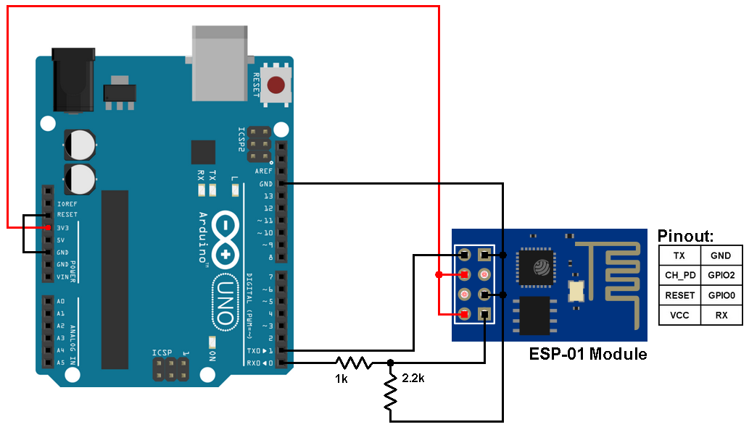
WIFI SHIELD:
THE ESP8266 WIFI MODULE IS SELF CONTAINED SOC WITH INTEGRATED TCP/IP STACK THAT CAN GIVE ANY MICROCONTROLLER ACCESS TO THE WIFI.
IT CAN COMMUNICATE WITH ANY MICROCONTROLLER AND MAKE PROJECT WIRELESS .

Slide 7
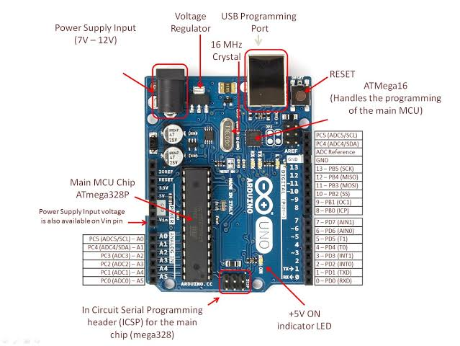
MICROCONTROLLER
ARDUINO UNO IS A MICRO CONTROLLER BOARD which simplifies the task of connecting to the Internet . It compares the received data with the threshold level set and accordingly output is generated
.

Slide 8
METHODOLOGY:
After setting up the Smart Dustbin and making all the necessary connections, upload the code to Arduino and provide 5V power supply to the circuit. Once the system is powered ON, Arduino keeps monitoring for any object near the Ultrasonic Sensor.
The Ultrasonic Sensor will be placed on interior side of lid that detects the level of garbage of each bin and sends this information to the arduino , the microcontroller that process the data calculates its distance and send to application with the help of wifi

Slide 9
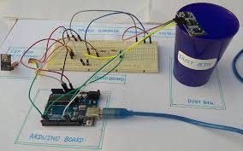
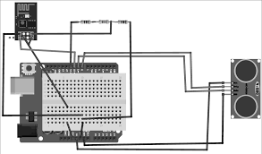
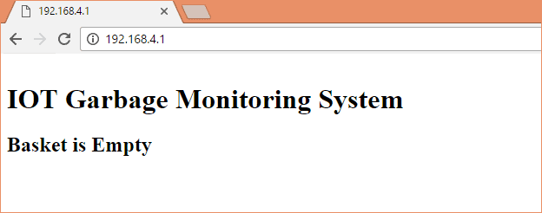

Slide 10
ADVANTAGES OF SMART GARBAGE SYSTEM
Easy to use
Low maintainence,non messy operation.
Reduces pollution and keeps the environment neat,fresh .
Dynamic routing.

